Slide 1

Noida Institute of Engineering and Technology, Greater Noida
OBJECT ORIENTED TECHNIQUES USING
JAVA
Unit: V
GUI Programming, Generics and Collections
B. TECH. IoT/ AIML
3rd Semester
Aditee Mattoo
Department IoT

Slide 2
Why learn GUIs?
Learn about event-driven programming techniques
Practice learning and using a large, complex API
A chance to see how it is designed and learn from it:
model-view separation
design patterns
refactoring vs. reimplementing an ailing API
Because GUIs are neat!
Caution: There is way more here than you can memorize.
Part of learning a large API is "letting go."
You won't memorize it all; you will look things up as you need them.
But you can learn the fundamental concepts and general ideas.

Slide 3

Java GUI History
Abstract Windowing Toolkit (AWT): Sun's initial effort to create a set of cross-platform GUI classes. (JDK 1.0 - 1.1)
Maps general Java code to each operating system's real GUI system.
Problems: Limited to lowest common denominator; clunky to use.
Swing: A newer GUI library written from the ground up that allows much more powerful graphics and GUI construction. (JDK 1.2+)
Paints GUI controls itself pixel-by-pixel rather than handing off to OS.
Benefits: Features; compatibility; OO design.
Problem: Both exist in Java now; easy to get them mixed up; still have to use both in various places.

Slide 4
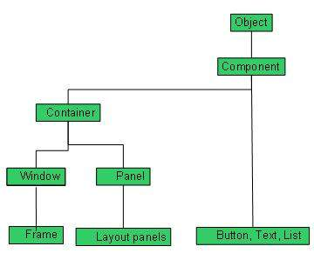
Every user interface considers the following three main aspects:
UI elements : These are the core visual elements the user eventually sees and interacts with. GWT provides a huge list of widely used and common elements varying from basic to complex which we will cover in this tutorial.
Layouts: They define how UI elements should be organized on the screen and provide a final look and feel to the GUI (Graphical User Interface). This part will be covered in Layout chapter.
Behavior: These are events which occur when the user interacts with UI elements.

Slide 5

GUI terminology
window: A first-class citizen of the graphical desktop.
Also called a top-level container.
examples: frame, dialog box, applet
component: A GUI widget that resides in a window.
Also called controls in many other languages.
examples: button, text box, label
container: A logical grouping for storing components.
examples: panel, box

Slide 6
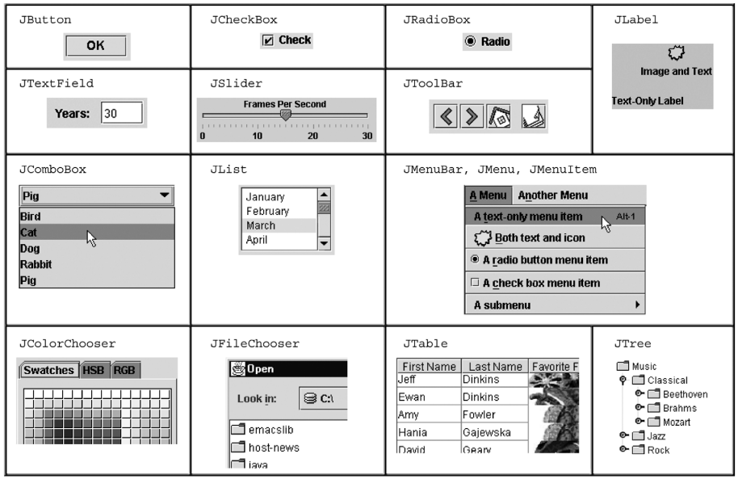
Components

Slide 7
Swing inheritance hierarchy
Component (AWT)
Window
Frame
JFrame (Swing)
JDialog
Container
JComponent (Swing)
JButton JColorChooser JFileChooser
JComboBox JLabel JList
JMenuBar JOptionPane JPanel
JPopupMenu JProgressBar JScrollbar
JScrollPane JSlider JSpinner
JSplitPane JTabbedPane JTable
JToolbar JTree JTextArea
JTextField ...

Slide 8
Component Properties
Each has a get (or is) accessor and a set modifier method.
examples: getColor, setFont, setEnabled, isVisible
name | type | description
background | Color | background color behind component
border | Border | border line around component
enabled | boolean | whether it can be interacted with
focusable | boolean | whether key text can be typed on it
font | Font | font used for text in component
foreground | Color | foreground color of component
height, width | int | component's current size in pixels
visible | boolean | whether component can be seen
tooltip text | String | text shown when hovering mouse
size, minimum / maximum / preferred size | Dimension | various sizes, size limits, or desired sizes that the component may take

Slide 9
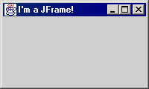
JFrame
a graphical window to hold other components
public JFrame() public JFrame(String title) Creates a frame with an optional title.
Call setVisible(true) to make a frame appear on the screen after creating it.
public void add(Component comp) Places the given component or container inside the frame.

Slide 10
More JFrame
public void setDefaultCloseOperation(int op) Makes the frame perform the given action when it closes.
Common value passed: JFrame.EXIT_ON_CLOSE
If not set, the program will never exit even if the frame is closed.
public void setSize(int width, int height) Gives the frame a fixed size in pixels.
public void pack() Resizes the frame to fit the components inside it snugly.

Slide 11
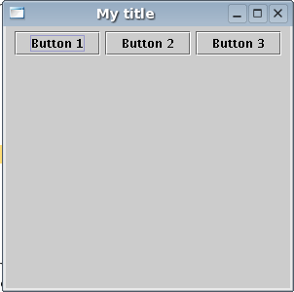
JButton
a clickable region for causing actions to occur
public JButton(String text) Creates a new button with the given string as its text.
public String getText() Returns the text showing on the button.
public void setText(String text) Sets button's text to be the given string.

Slide 12
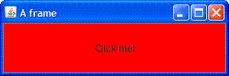
GUI example
import java.awt.*; // Where is the other button?
import javax.swing.*;
public class GuiExample1 {
public static void main(String[] args) {
JFrame frame = new JFrame();
frame.setDefaultCloseOperation(JFrame.EXIT_ON_CLOSE);
frame.setSize(new Dimension(300, 100));
frame.setTitle("A frame");
JButton button1 = new JButton();
button1.setText("I'm a button.");
button1.setBackground(Color.BLUE);
frame.add(button1);
JButton button2 = new JButton();
button2.setText("Click me!");
button2.setBackground(Color.RED);
frame.add(button2);
frame.setVisible(true);
}
}

Slide 13
Sizing and positioning
How does the programmer specify where each component appears, how big each component should be, and what the component should do if the window is resized / moved / maximized / etc.?
Absolute positioning (C++, C#, others): Programmer specifies exact pixel coordinates of every component.
"Put this button at (x=15, y=75) and make it 70x31 px in size."
Layout managers (Java): Objects that decide where to position each component based on some general rules or criteria.
"Put these four buttons into a 2x2 grid and put these text boxes in a horizontal flow in the south part of the frame."

Slide 14
Java LayoutManagers
The LayoutManagers are used to arrange components in a particular manner. The Java LayoutManagers facilitates us to control the positioning and size of the components in GUI forms. LayoutManager is an interface that is implemented by all the classes of layout managers. There are the following classes that represent the layout managers:
java.awt.BorderLayout
java.awt.FlowLayout
java.awt.GridLayout
java.awt.CardLayout
java.awt.GridBagLayout
javax.swing.BoxLayout
javax.swing.GroupLayout
javax.swing.ScrollPaneLayout
javax.swing.SpringLayout etc.

Slide 15
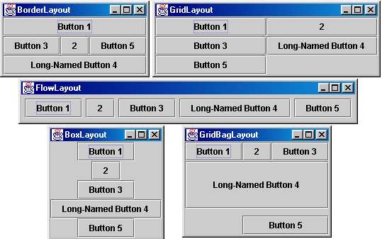
Containers and layout
Place components in a container; add the container to a frame.
container: An object that stores components and governs their positions, sizes, and resizing behavior.

Slide 16
JFrame as container
A JFrame is a container. Containers have these methods:
public void add(Component comp) public void add(Component comp, Object info) Adds a component to the container, possibly giving extra information about where to place it.
public void remove(Component comp)
public void setLayout(LayoutManager mgr) Uses the given layout manager to position components.
public void validate() Refreshes the layout (if it changes after the container is onscreen).

Slide 17

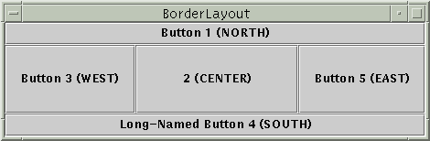
Preferred sizes
Swing component objects each have a certain size they would "like" to be: Just large enough to fit their contents (text, icons, etc.).
This is called the preferred size of the component.
Some types of layout managers (e.g. FlowLayout) choose to size the components inside them to the preferred size.
Others (e.g. BorderLayout, GridLayout) disregard the preferred size and use some other scheme to size the components.
Buttons at preferred size: Not preferred size:

Slide 18
FlowLayout
public FlowLayout()
treats container as a left-to-right, top-to-bottom "paragraph".
Components are given preferred size, horizontally and vertically.
Components are positioned in the order added.
If too long, components wrap around to the next line.
myFrame.setLayout(new FlowLayout());
myFrame.add(new JButton("Button 1"));
The default layout for containers other than JFrame (seen later).

Slide 19
BorderLayout
public BorderLayout()
Divides container into five regions:
NORTH and SOUTH regions expand to fill region horizontally, and use the component's preferred size vertically.
WEST and EAST regions expand to fill region vertically, and use the component's preferred size horizontally.
CENTER uses all space not occupied by others.
myFrame.setLayout(new BorderLayout());
myFrame.add(new JButton("Button 1"), BorderLayout.NORTH);
This is the default layout for a JFrame.

Slide 20
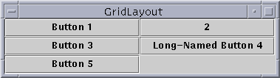
GridLayout
public GridLayout(int rows, int columns)
Treats container as a grid of equally-sized rows and columns.
Components are given equal horizontal / vertical size, disregarding preferred size.
Can specify 0 rows or columns to indicate expansion in that direction as needed.

Slide 21
Event Listeners

Slide 22
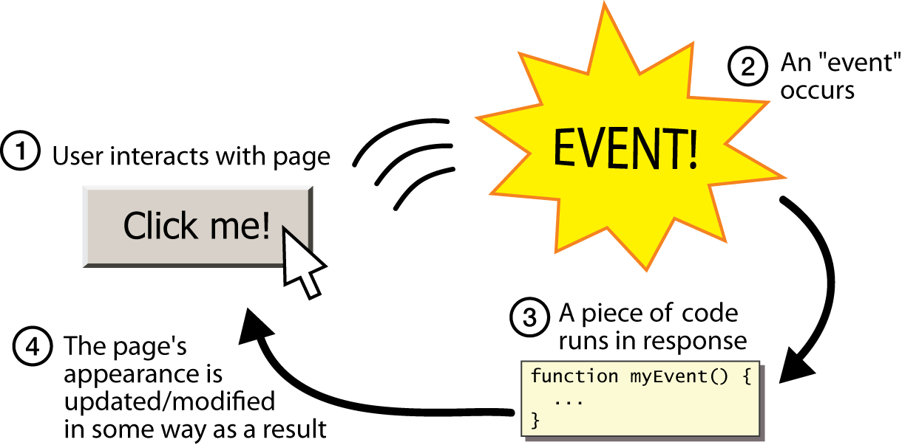
Graphical events
event: An object that represents a user's interaction with a GUI component; can be "handled" to create interactive components.
listener: An object that waits for events and responds to them.
To handle an event, attach a listener to a component.
The listener will be notified when the event occurs (e.g. button click).

Slide 23
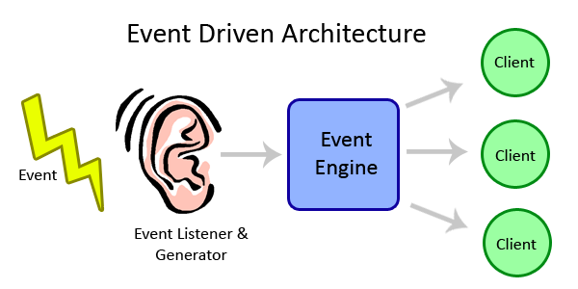
Event-driven programming
event-driven programming: A style of coding where a program's overall flow of execution is dictated by events.
Rather than a central "main" method that drives execution, the program loads and waits for user input events.
As each event occurs, the program runs particular code to respond.
The overall flow of what code is executed is determined by the series of events that occur, not a pre-determined order.

Slide 24
Event hierarchy
EventObject
AWTEvent (AWT)
ActionEvent
TextEvent
ComponentEvent
FocusEvent
WindowEvent
InputEvent
KeyEvent
MouseEvent
EventListener
AWTEventListener
ActionListener
TextListener
ComponentListener
FocusListener
WindowListener
KeyListener
MouseListener

Slide 25

Action events
action event: An action that has occurred on a GUI component.
The most common, general event type in Swing. Caused by:
button or menu clicks,
check box checking / unchecking,
pressing Enter in a text field, ...
Represented by a class named ActionEvent
Handled by objects that implement interface ActionListener

Slide 26
Implementing a listener
public class name implements ActionListener {
public void actionPerformed(ActionEvent event) {
code to handle the event;
}
}
JButton and other graphical components have this method:
public void addActionListener(ActionListener al) Attaches the given listener to be notified of clicks and events that occur on this component.

Slide 27

Nested classes
nested class: A class defined inside of another class.
Usefulness:
Nested classes are hidden from other classes (encapsulated).
Nested objects can access/modify the fields of their outer object.
Event listeners are often defined as nested classes inside a GUI.

Slide 28
Nested class syntax
// enclosing outer class
public class name {
...
// nested inner class
private class name {
...
}
}
Only the outer class can see the nested class or make objects of it.
Each nested object is associated with the outer object that created it, so it can access/modify that outer object's methods/fields.
If necessary, can refer to outer object as OuterClassName.this

Slide 29
Static inner classes
// enclosing outer class
public class name {
...
// non-nested static inner class
public static class name {
...
}
}
Static inner classes are not associated with a particular outer object.
They cannot see the fields of the enclosing class.
Usefulness: Clients can refer to and instantiate static inner classes:
Outer.Inner name = new Outer.Inner(params);

Slide 30
Java 2 Collections
A collection is an object that groups multiple elements into a single unit
Very useful
store, retrieve and manipulate data
transmit data from one method to another
data structures and methods written by hotshots in the field
Joshua Bloch, who also wrote the Collections tutorial

Slide 31
Collections Framework
Unified architecture for representing and manipulating collections.
A collections framework contains three things
Interfaces
Implementations
Algorithms

Slide 32
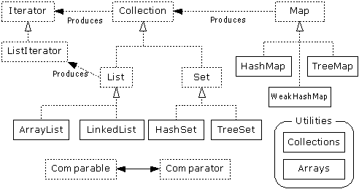
Collections Framework Diagram
Interfaces, Implementations, and Algorithms
From Thinking in Java, page 462

Slide 33
Collection Interface
Defines fundamental methods
int size();
boolean isEmpty();
boolean contains(Object element);
boolean add(Object element); // Optional
boolean remove(Object element); // Optional
Iterator iterator();
These methods are enough to define the basic behavior of a collection
Provides an Iterator to step through the elements in the Collection

Slide 34
Iterator Interface
Defines three fundamental methods
Object next()
boolean hasNext()
void remove()
These three methods provide access to the contents of the collection
An Iterator knows position within collection
Each call to next() “reads” an element from the collection
Then you can use it or remove it

Slide 35
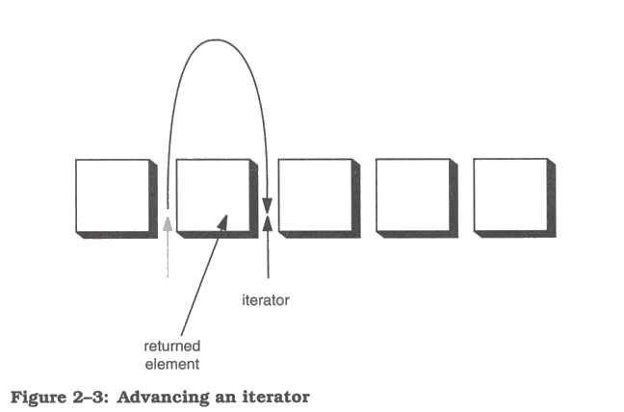
Iterator Position

Slide 36
Example - SimpleCollection
public class SimpleCollection {
public static void main(String[] args) {
Collection c;
c = new ArrayList();
System.out.println(c.getClass().getName());
for (int i=1; i <= 10; i++) {
c.add(i + " * " + i + " = "+i*i);
}
Iterator iter = c.iterator();
while (iter.hasNext())
System.out.println(iter.next());
}
}

Slide 37
List Interface Context
Collection
List

Slide 38
List Interface
The List interface adds the notion of order to a collection
The user of a list has control over where an element is added in the collection
Lists typically allow duplicate elements
Provides a ListIterator to step through the elements in the list.

Slide 39
ListIterator Interface
Extends the Iterator interface
Defines three fundamental methods
void add(Object o) - before current position
boolean hasPrevious()
Object previous()
The addition of these three methods defines the basic behavior of an ordered list
A ListIterator knows position within list

Slide 40
Iterator Position - next(), previous()

Slide 41
ArrayList and LinkedList Context
Collection
List
ArrayList
LinkedList

Slide 42
List Implementations
ArrayList
low cost random access
high cost insert and delete
array that resizes if need be
LinkedList
sequential access
low cost insert and delete
high cost random access

Slide 43
ArrayList overview
Constant time positional access (it’s an array)
One tuning parameter, the initial capacity
public ArrayList(int initialCapacity) {
super();
if (initialCapacity < 0)
throw new IllegalArgumentException(
"Illegal Capacity: "+initialCapacity);
this.elementData = new Object[initialCapacity];
}

Slide 44
ArrayList methods
The indexed get and set methods of the List interface are appropriate to use since ArrayLists are backed by an array
Object get(int index)
Object set(int index, Object element)
Indexed add and remove are provided, but can be costly if used frequently
void add(int index, Object element)
Object remove(int index)
May want to resize in one shot if adding many elements
void ensureCapacity(int minCapacity)

Slide 45
LinkedList overview
Stores each element in a node
Each node stores a link to the next and previous nodes
Insertion and removal are inexpensive
just update the links in the surrounding nodes
Linear traversal is inexpensive
Random access is expensive
Start from beginning or end and traverse each node while counting

Slide 46
LinkedList entries
private static class Entry {
Object element;
Entry next;
Entry previous;
Entry(Object element, Entry next, Entry previous) {
this.element = element;
this.next = next;
this.previous = previous;
}
}
private Entry header = new Entry(null, null, null);
public LinkedList() {
header.next = header.previous = header;
}

Slide 47
LinkedList methods
The list is sequential, so access it that way
ListIterator listIterator()
ListIterator knows about position
use add() from ListIterator to add at a position
use remove() from ListIterator to remove at a position
LinkedList knows a few things too
void addFirst(Object o), void addLast(Object o)
Object getFirst(), Object getLast()
Object removeFirst(), Object removeLast()

Slide 48
Set Interface Context
Collection
Set

Slide 49
Set Interface
Same methods as Collection
different contract - no duplicate entries
Defines two fundamental methods
boolean add(Object o) - reject duplicates
Iterator iterator()
Provides an Iterator to step through the elements in the Set
No guaranteed order in the basic Set interface
There is a SortedSet interface that extends Set

Slide 50
HashSet and TreeSet Context
Collection
Set
HashSet
TreeSet

Slide 51
HashSet
Find and add elements very quickly
uses hashing implementation in HashMap
Hashing uses an array of linked lists
The hashCode() is used to index into the array
Then equals() is used to determine if element is in the (short) list of elements at that index
No order imposed on elements
The hashCode() method and the equals() method must be compatible
if two objects are equal, they must have the same hashCode() value

Slide 52
TreeSet
Elements can be inserted in any order
The TreeSet stores them in order
Red-Black Trees out of Cormen-Leiserson-Rivest
An iterator always presents them in order
Default order is defined by natural order
objects implement the Comparable interface
TreeSet uses compareTo(Object o) to sort
Can use a different Comparator
provide Comparator to the TreeSet constructor

Slide 53
Map Interface Context
Map

Slide 54
Map Interf
Stores key/value pairs
Maps from the key to the value
Keys are unique
a single key only appears once in the Map
a key can map to only one value
Values do not have to be unique

Slide 55
Map methods
Object put(Object key, Object value)
Object get(Object key)
Object remove(Object key)
boolean containsKey(Object key)
boolean containsValue(Object value)
int size()
boolean isEmpty()

Slide 56
Map views
A means of iterating over the keys and values in a Map
Set keySet()
returns the Set of keys contained in the Map
Collection values()
returns the Collection of values contained in the Map. This Collection is not a Set, as multiple keys can map to the same value.
Set entrySet()
returns the Set of key-value pairs contained in the Map. The Map interface provides a small nested interface called Map.Entry that is the type of the elements in this Set.

Slide 57
HashMap and TreeMap Context
Map
HashMap
TreeMap

Slide 58
HashMap and TreeMap
HashMap
The keys are a set - unique, unordered
Fast
TreeMap
The keys are a set - unique, ordered
Same options for ordering as a TreeSet
Natural order (Comparable, compareTo(Object))
Special order (Comparator, compare(Object, Object))

Slide 59
Bulk Operations
In addition to the basic operations, a Collection may provide “bulk” operations
boolean containsAll(Collection c);
boolean addAll(Collection c); // Optional
boolean removeAll(Collection c); // Optional
boolean retainAll(Collection c); // Optional
void clear(); // Optional
Object[] toArray();
Object[] toArray(Object a[]);

Slide 60
Utilities Context

Slide 61
Utilities
The Collections class provides a number of static methods for fundamental algorithms
Most operate on Lists, some on all Collections
Sort, Search, Shuffle
Reverse, fill, copy
Min, max
Wrappers
synchronized Collections, Lists, Sets, etc
unmodifiable Collections, Lists, Sets, etc

Slide 62
More Legacy classes
Vector
use ArrayList
Stack
use LinkedList
BitSet
use ArrayList of boolean, unless you can’t stand the thought of the wasted space
Properties
legacies are sometimes hard to walk away from …
see next few pages

Slide 63
Properties class
Located in java.util package
Special case of Hashtable
Keys and values are Strings
Tables can be saved to/loaded from file

Slide 64
System properties
Java VM maintains set of properties that define system environment
Set when VM is initialized
Includes information about current user, VM version, Java environment, and OS configuration
Properties prop = System.getProperties();
Enumeration e = prop.propertyNames();
while (e.hasMoreElements()) {
String key = (String) e.nextElement();
System.out.println(key + " value is " +
prop.getProperty(key));
}

Slide 65
MCQs
1. Which of the following is incorrect statement regarding the use of generics and parameterized types in Java?
A. Generics provide type safety by shifting more type checking responsibilities to the compiler
B. Generics and parameterized types eliminate the need for down casts when using Java Collections
C. When designing your own collections class (say, a linked list), generics and parameterized types allow you to achieve type safety with just a single class definition as opposed to defining multiple classes
Answer: C
2. Which of the following allows us to call generic methods as a normal method?
A. Type Interface
B. Interface
C. Inner class
D. All of the mentioned
Answer: A

Slide 66
MCQs
3. Why are generics used?
A. Generics make code more fast
B. Generics make code more optimised and readable
C. Generics add stability to your code by making more of your bugs detectable at compile time
D. Generics add stability to your code by making more of your bugs detectable at a runtime
Answer: C
4. Which of the following reference types cannot be generic?
A. Anonymous inner class
B. Interface
C. Inner class
D. All of the mentioned
Answer: A

Slide 67
MCQs
5. Which of these types cannot be used to initiate a generic type?
A. Integer class
B. Float Class
C. Primitive Types
D. Collections
Answer: C
6. Which of these instances cannot be created?
A. Integer Instance
B. Generic Class Instance
C. Generic Type Instance
D. Collection Instances
Answer: C

Slide 68
MCQs
7. Which of these is a correct way of defining of a generic method?
A. name(T1, T2, …, Tn) { /* … */ }
B. public name { /* … */ }
C. class name[T1, T2, …, Tn] { /* … */ }
D. name{T1, T2, …, Tn} { /* … */ }
Answer: B
8. Which of these package is used for graphical user interface?
java.applet
java.awt
java.awt.image
java.io
Answer: B

Slide 69
9. Where are the following four methods commonly used? 1) public void add(Component c) 2) public void setSize(int width,int height) 3) public void setLayout(LayoutManager m) 4) public void setVisible(boolean) a. Graphics class
b. Component class
c. Both A & B
d. None of the above
Answer: B
10. Which is the container that doesn't contain title bar and MenuBars but it can have other components like button, textfield etc? a. Window
b. Frame
c. Panel
d. Container
Answer : C

Slide 70
MCQs
11. Which package provides many event classes and Listener interfaces for event handling? a. java.awt
b. java.awt.Graphics
c. java.awt.event
d. None of the above
Answer: c
12. Which is a component in AWT that can contain another components like buttons, textfields, labels etc.? a. Window
b. Container
c. Panel
d. Frame
Answer: b

Slide 71
SAQs
What is the Collection framework in Java?
What are the main differences between array and collection?
Explain various interfaces used in Collection framework?
What is the difference between ArrayList and Vector?
What is the difference between ArrayList and LinkedList?
What is the difference between Iterator and ListIterator?
What is the difference between Iterator and Enumeration?
What is the difference between List and Set?
What is the difference between Set and Map?
What is the difference between HashSet and HashMap?
What is the difference between Collection and Collections?
What is the difference between Comparable and Comparator?
What is the advantage of the generic collection?
What is the difference between Array and ArrayList?
How to reverse ArrayList?
What is a Container Class?
What is GUI in Java?

Slide 72
Thank You

